Slide 1
TCES 330
How to Get Rid of Synopsys Warnings and Find Fmax
In One Easy Lesson

Slide 2
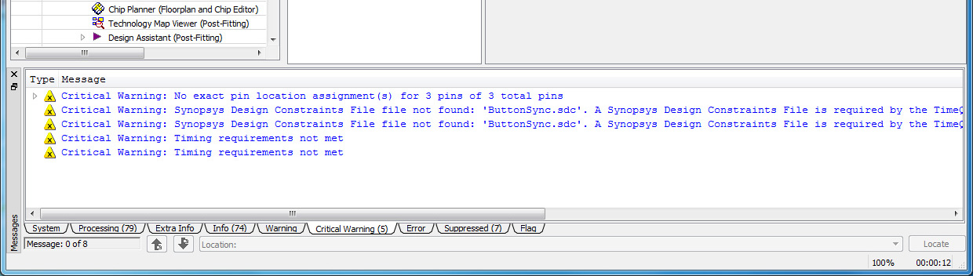
If You Have Warning Like This

Slide 3
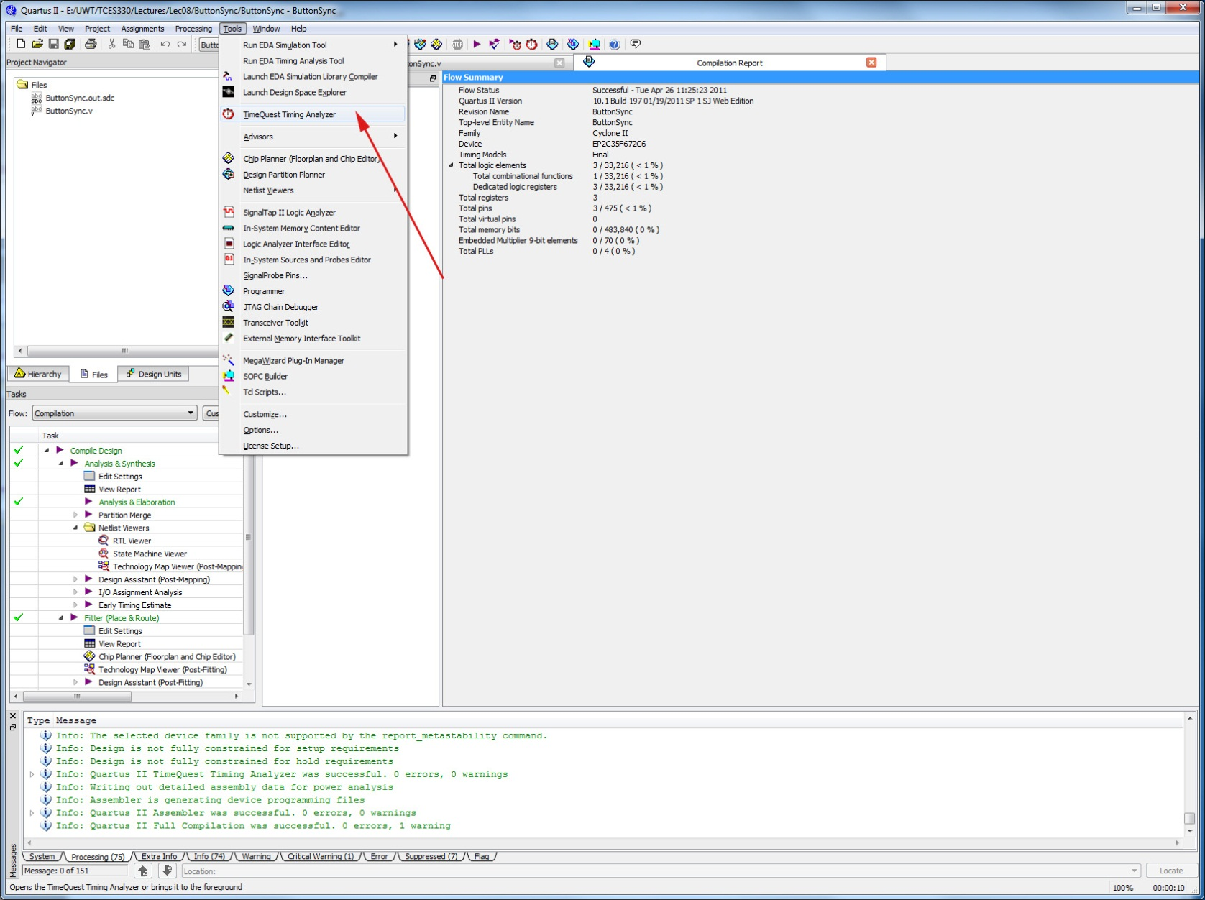
Run the TimeQuest Timing Analyzer

Slide 4
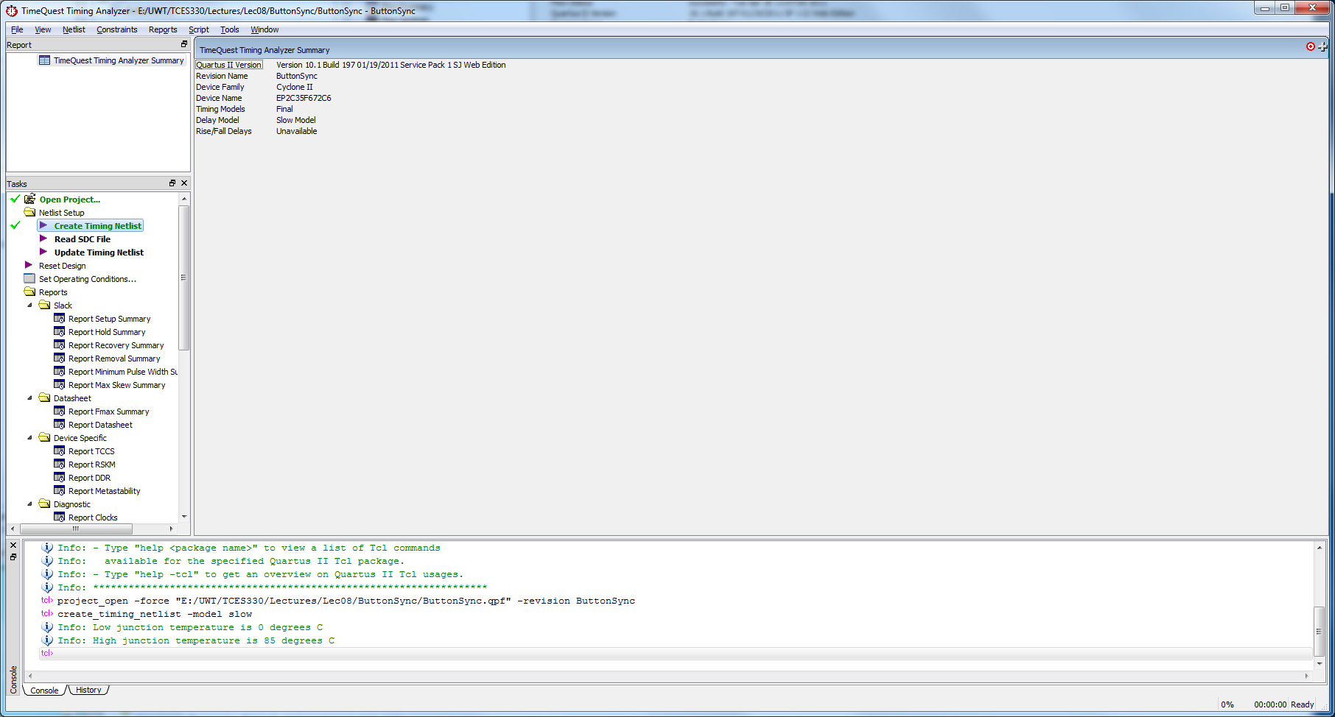
Create Netlist
Double-click here

Slide 5
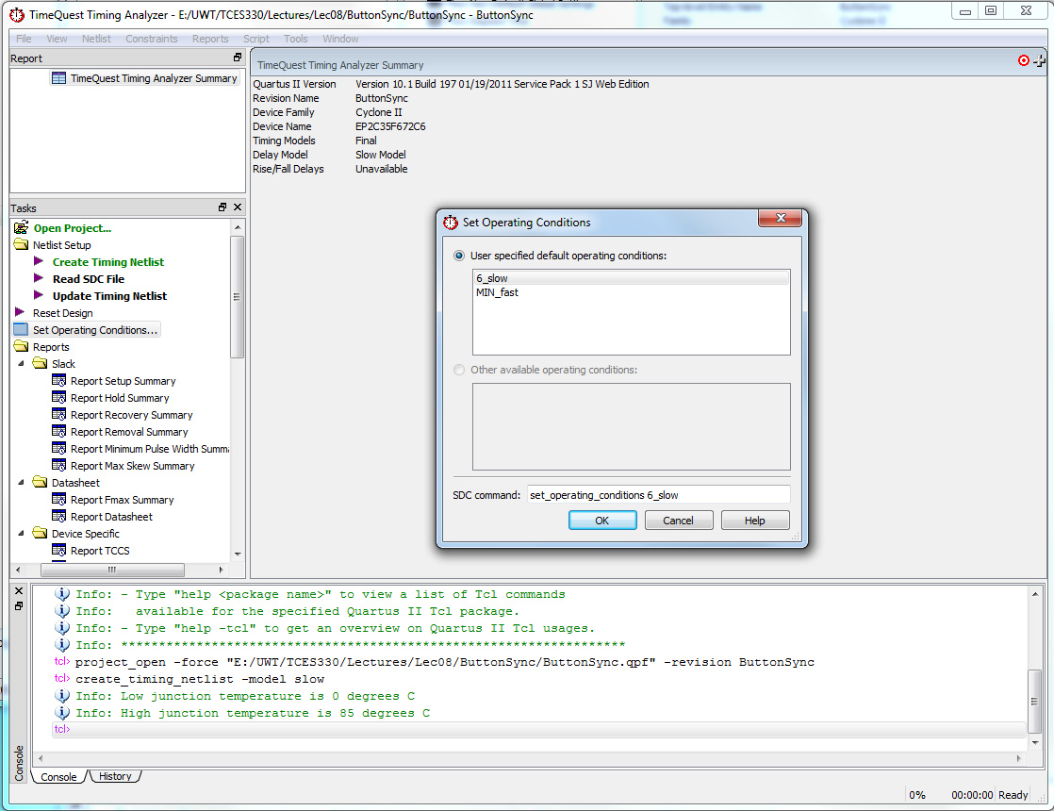
Set Operating Conditions
This is an optional step
Double-
Click
Here
Then
Click
Here

Slide 6
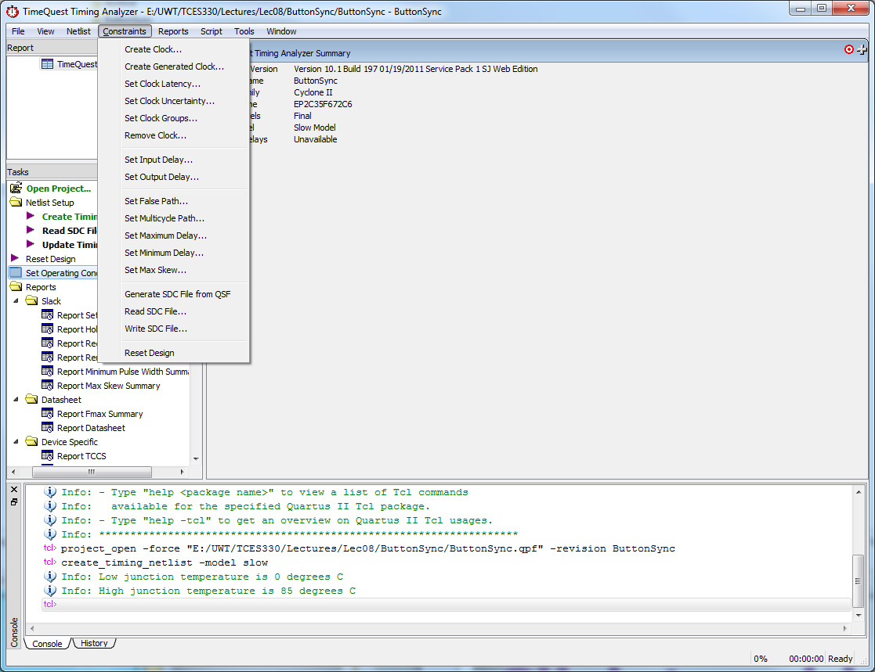
Constraints/Create Clock…

Slide 7
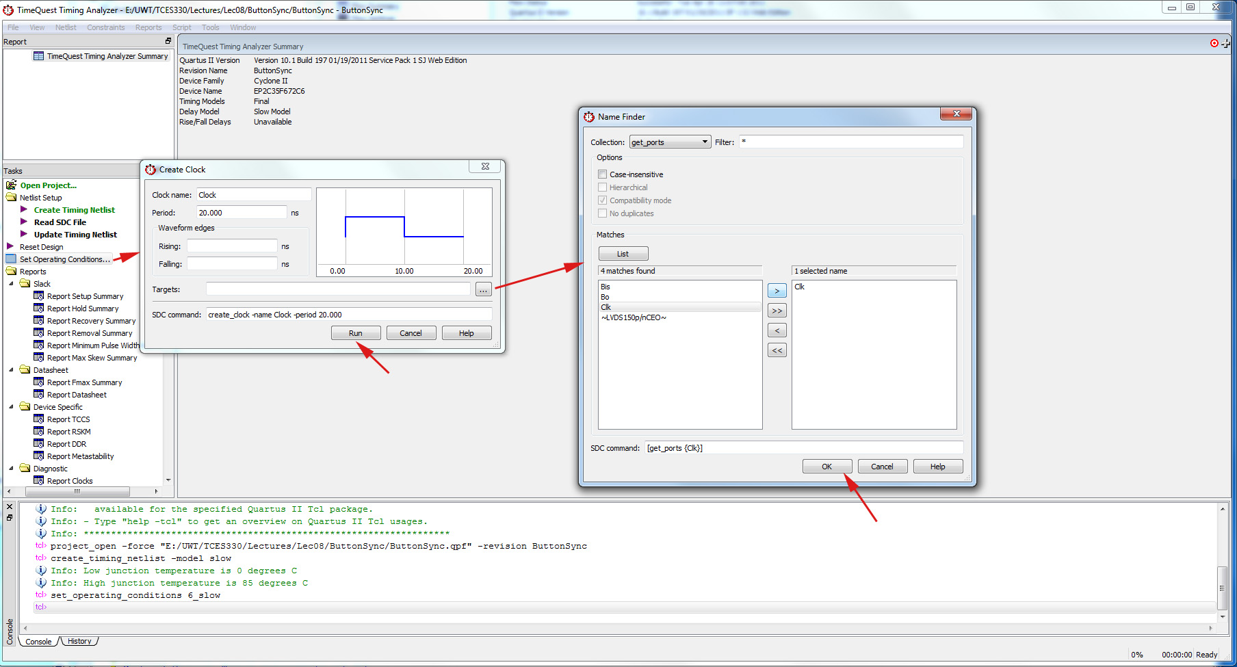
Creating The Clock
1
Fill in Clock Name and Period (usually 20 ns)
3
Get your clock
into this column
2
5
4

Slide 8
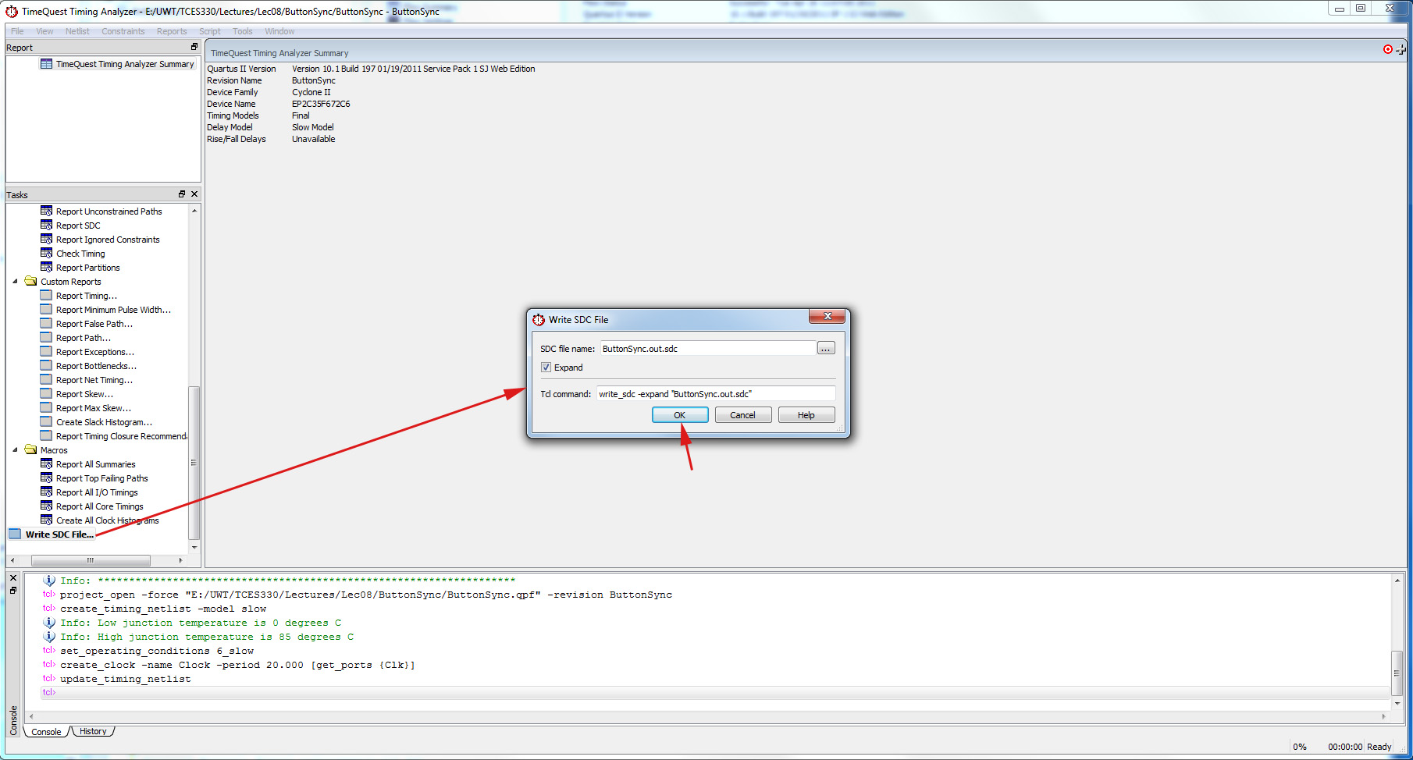
Write the SDC File
2
Note the SDC file name
2
1
Double Click Here
3

Slide 9
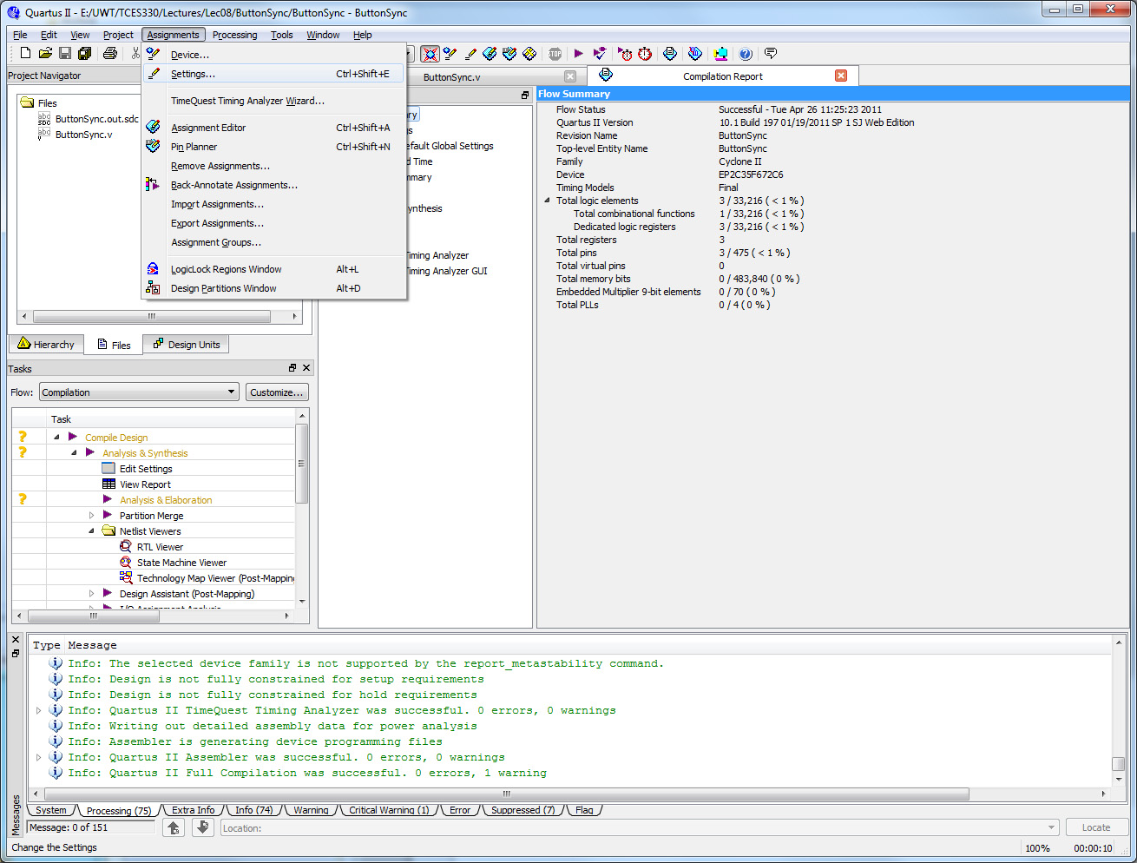
Back in Quartus

Slide 10
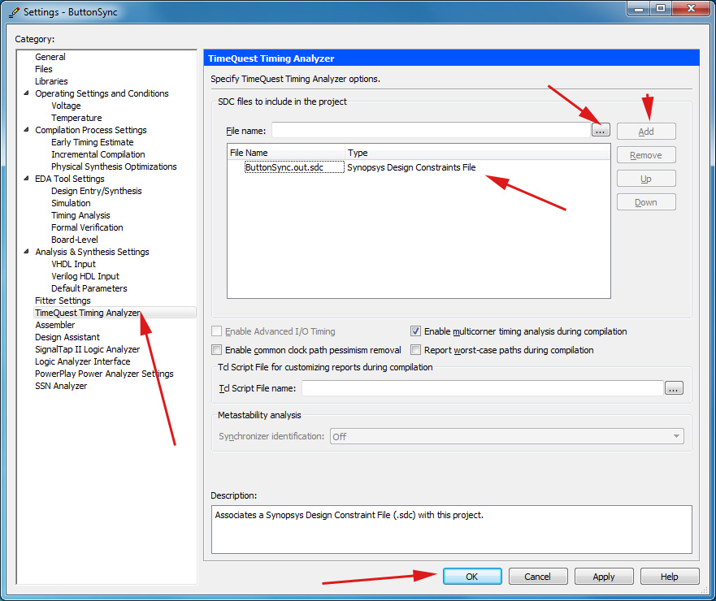
TimeQuest Settings in Quartus
Find your SDC file
2
3
4
Get your SDC file to appear here
1
5

Slide 11
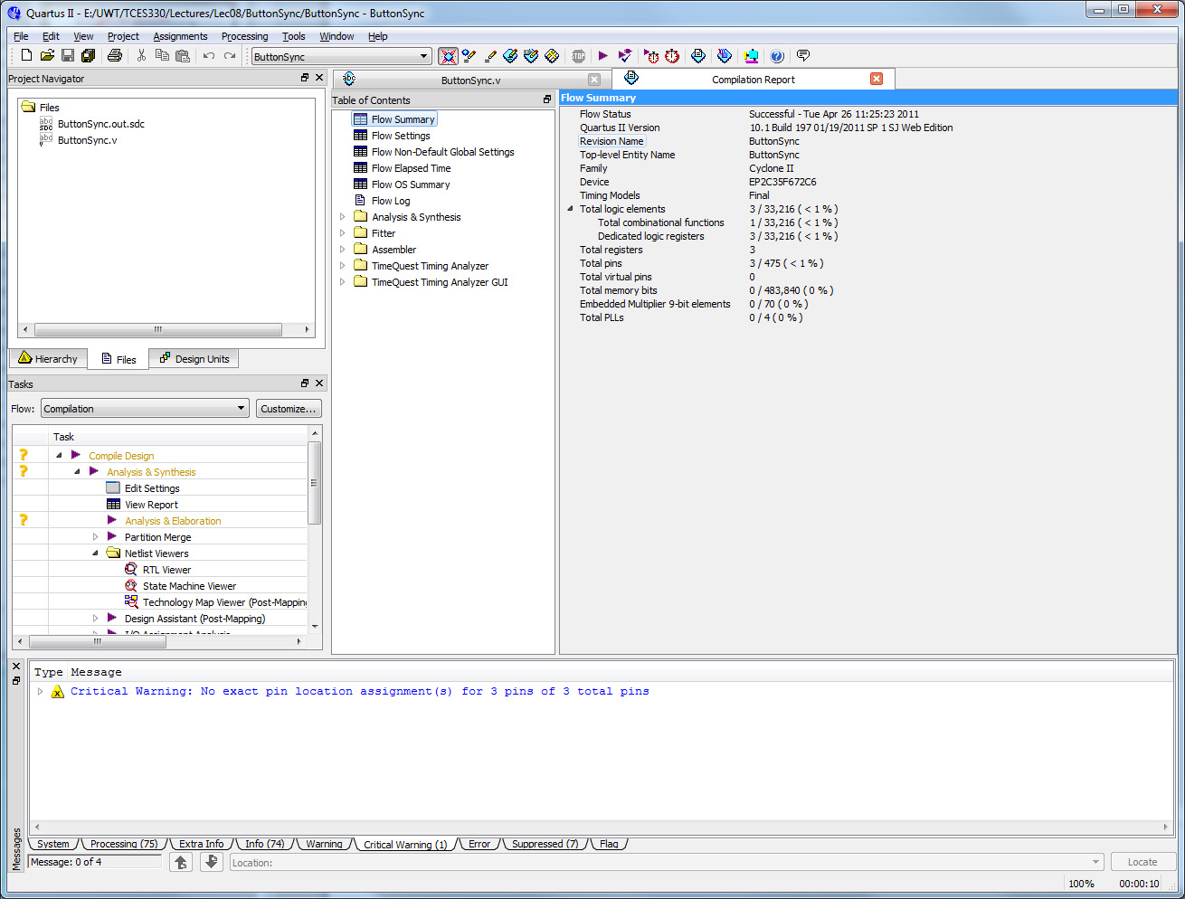
Recompile
Then just recompile.
And the timing warnings should be gone.

Slide 12
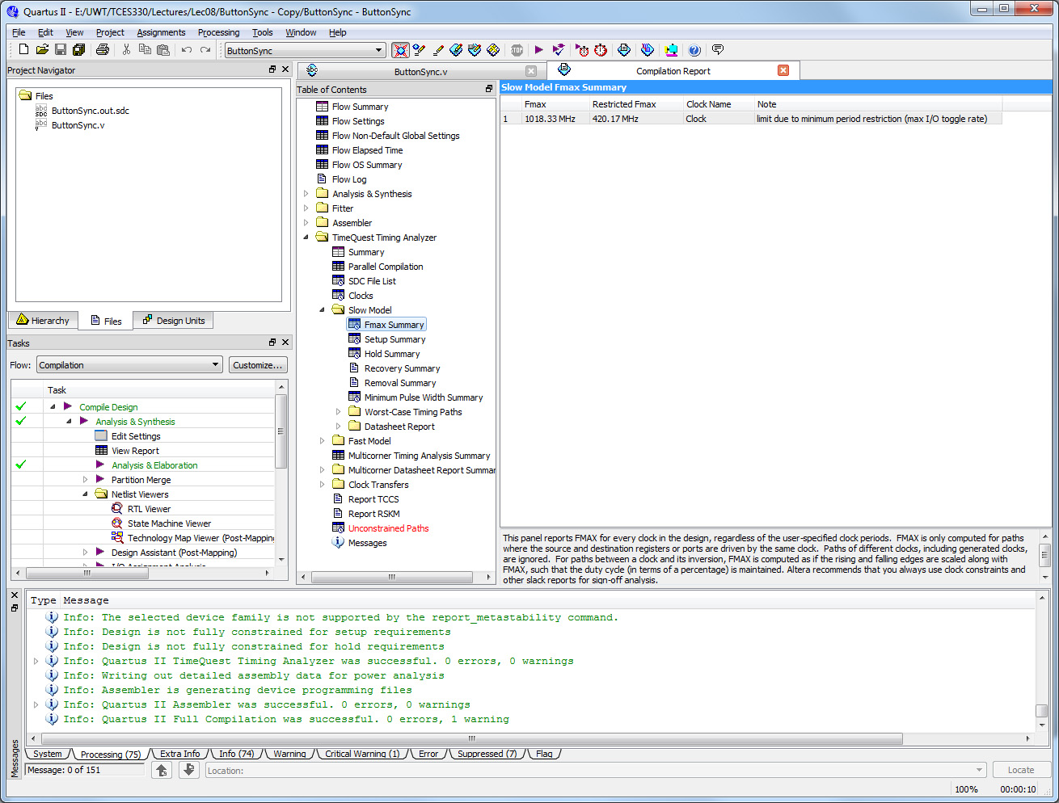
And Now You Can Find Fmax
And Fmax is here.
Click here.

